Slide 1

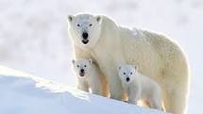
Polar Bears
by Marko Vasic

Slide 2
Table of Contents
Polar Bears Habitat
Physical Description
Diet
Shelter and Predators
Polar Bears’ Adaptations I
Polar Bears’ Adaptations II

Slide 3
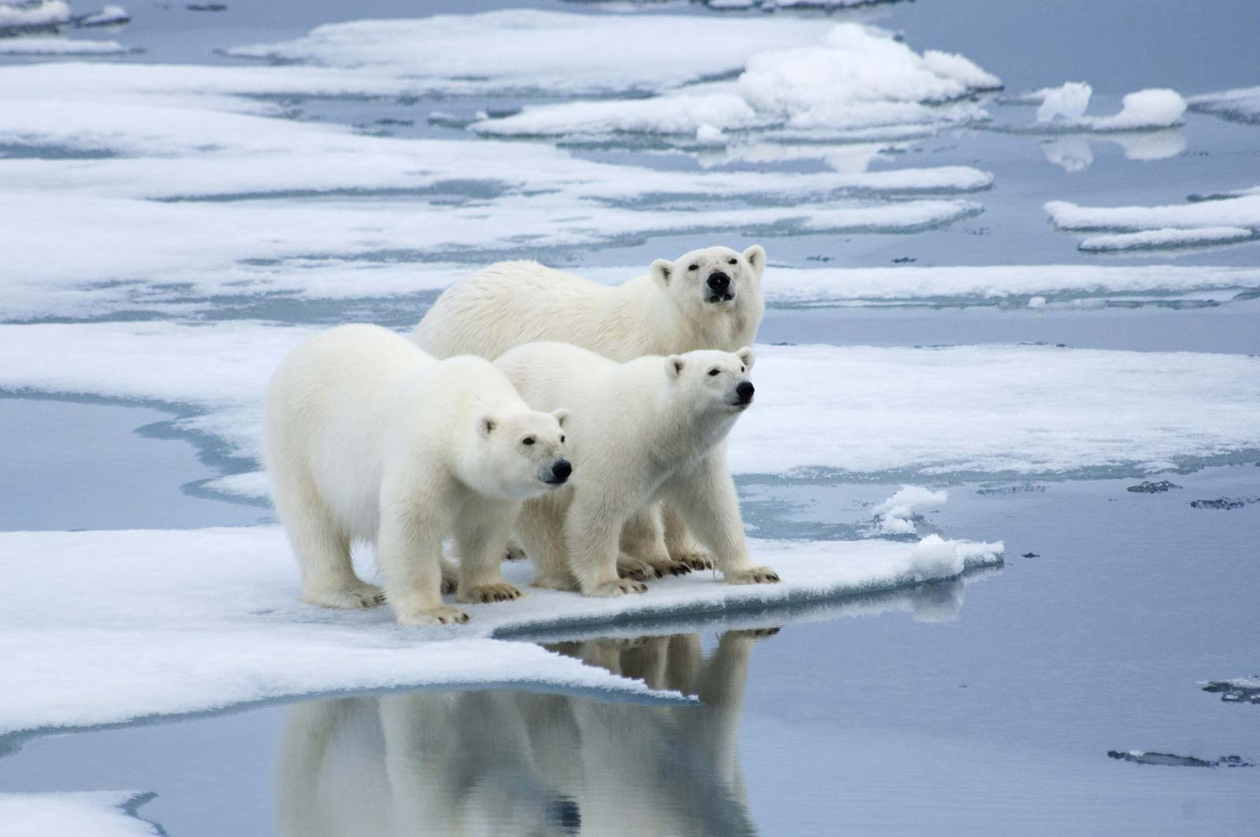
Polar Bears Habitat
Polar Bears are found in Arctic Tundra biome. Arctic Tundra is located on the Northern Hemisphere. It is known for its cold, desert-like conditions. In the winter, temperatures are usually around - 29 degrees Fahrenheit and could be as low as - 92 F. The growing season lasts from 50 to 60 days annually.
Polar Bears are adapted to living in the cold weather, they have two layers of fur and a thick layer of body fat.

Slide 4
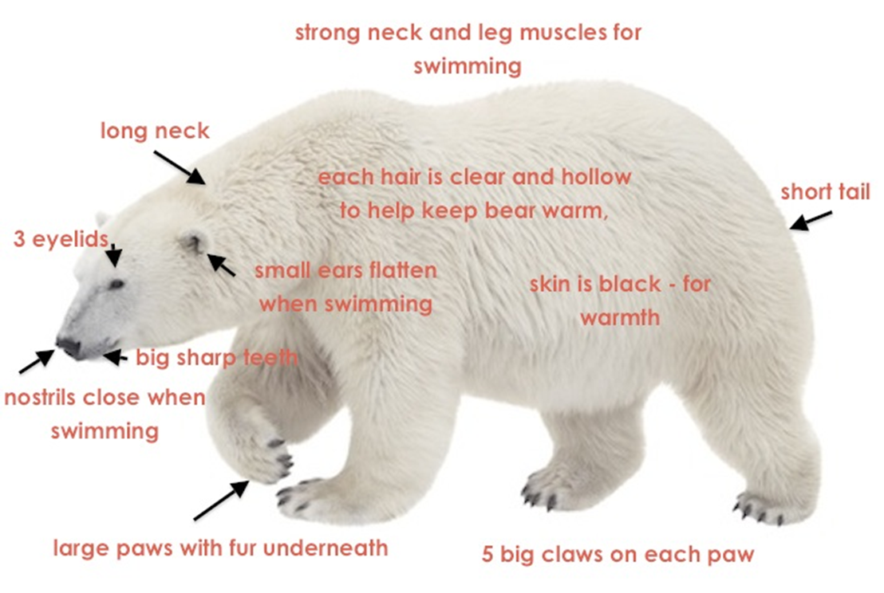
Physical Description
Polar Bears are Marine mammals - because they depend on the ocean for their food and habitat.
The Polar Bear is the largest land carnivore.
Polar Bears have two layers of fur and a thick layer of body fat. They have a strong neck and leg muscles for swimming.
The color of coat can vary from pure white to light brown depending upon season.
The head is small compared to body size. The nose is broad and black. Nostrils close when swimming.
Polar Bears have five big claws on each paw, which help them to move on the snow and ice.
The Polar Bear moves by walking or running on the land and swimming in the Ocean.

Slide 5
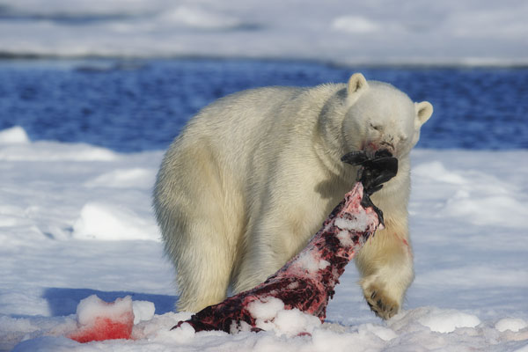
Diet
Polar Bears mainly eat seals.
Sometimes they also eat whales and walruses.
Polar Bears can survive the summer and autumn months on limited food sources. This is only possible if Polar Bears can gain enough fat during the hunting season in Spring and reduce the body metabolism to burn as little fat as possible.

Slide 6
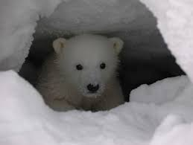
Shelter and Predators
Polar Bears set up dens in the snow and ice for shelter during the winter and to give birth to a cub.
Polar Bears have no natural predators. Walruses and wolves can kill Polar Bears’ cubs.

Slide 7
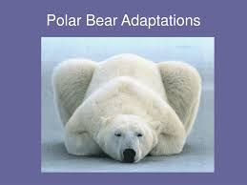
Polar Bears’ Adaptations I
Feeding - Physical adaptations:
Polar Bears have strong legs for swimming fast through icy water and catching the food.
Polar Bears have an excellent sense of smell to help them find the prey.
Polar Bears long, sharp claws help them pull seals out of the water onto the ice where the bears can eat.
Feeding – Behavioral adaptations:
Most bears are omnivores and eat plants. But where Polar Bears live, there is almost no plants available, so they have adapted a carnivorous lifestyle.
Breathing - Physical adaptations:
The Polar bears have large lungs to stay under the water for around three minutes at a time and catch the food.
Defense:
Survival:
Polar Bears have thick white fur for camouflage and warmth.
Polar Bears have thick, rough paws for grip and walk on snow and ice.
Other:

Slide 8
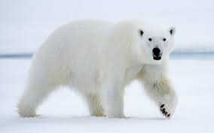
Polar Bears’ Adaptations II
Defense - Physical adaptations:
Polar Bears have white fur so that they can camouflage into their environment and to hid from dangers.
Survival - Physical adaptations:
Polar Bears have thick, rough paws for grip and walk on snow and ice.
A webbed feet helps Polar Bears to swim and from slipping up on the ice!
Polar Bears have layer of fat for insulation against the cold!
Polar Bears have a thick fur that helps them dry off!
Survival – Behavioral adaptations:
Polar bears dig dens to protect and hide themselves from cold winds.
Other – Physical adaptations:
Polar Bears have three eyelids. The third eyelid help protect their eyes in such a severe climate in Artic.

Slide 9
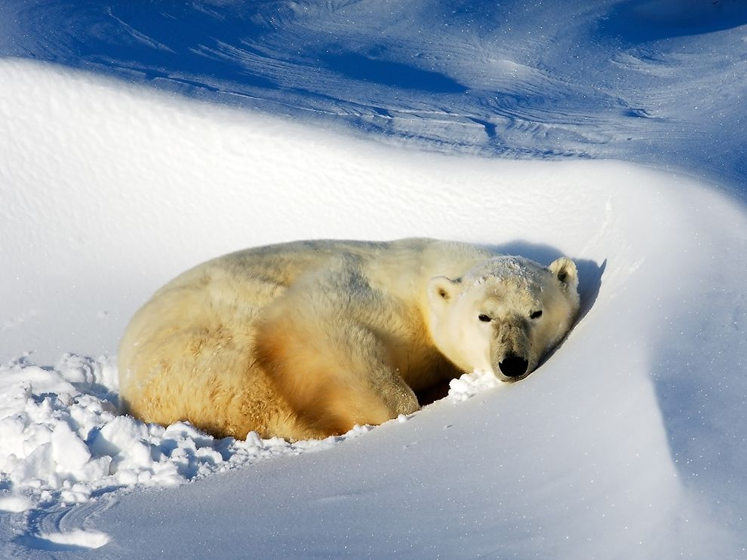
THANK YOU FOR YOUR ATTENTION!

